Slide 1
Human resources slide 1
AN ANALYSIS OF AMAZON SALES DATA
Vic Millar
Thomas Lento
Cheromainè Smith
Jordan Epstein

Slide 2
Human resources slide 2
SELECTING THE DATASET
We explored several options for datasets, initially settling on one containing stats from last year's NFL season, but ultimately deciding we wanted something more business-facing.
The dataset chosen contains sales data from Amazon during the 2020 calendar year.
This dataset will offer insights through analysis into what really drives sales for Amazon, while also looking at other impactful data like discount and ratings.
Our overall goal is to be able to provide insight to Amazon executives showing areas of strength, places to improve, and to hypothesize through correlation how and why certain categories perform the way they do.

Slide 3

Human resources slide 3
REMOVING NA'S (NOT AVAILABLE)
REMOVING MISSING INFORMATION
REMOVING UNIQUE CHARACTERS ( ₹ IN OUR CASE)
CLEANING THE DATA
FORMATTING INVALID FIELDS

Slide 4
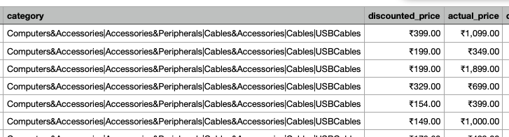
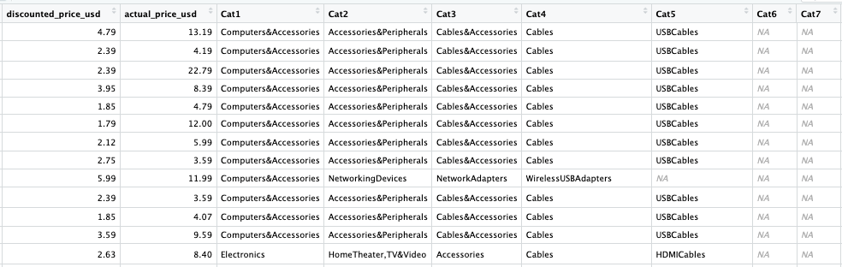
Human resources slide 3
CLEANING THE DATA

Slide 5
Human resources slide 3
1. Which top level category brought in the most revenue for Amazon?
2. What is the average rating by broad category (Tier 1, ex. Electronics)? What is the average rating by price? Can both be visualized in the same graph?
3. What are the top 5 selling products (based on number of ratings), and what are the top 5 products based on revenue (rating count x discounted price)? How many products overlap of each set of 5?
4. What is the average price discount by Tier 1 category?
5. Key Word Analysis: What words appear the most frequently in the About, Review Title and User Reviews section? Visualize this sentiment analysis.
6. Are we able to accurately predict the user rating based on key words and price discount percentage?
Business Questions
7. Are good or bad user feelings about a product more likely to generate a high volume or ratings and reviews? Are users more motivated to write a good product review or a bad product review?
8. How are ratings distributed based on quantity of ratings?
9. Is there a way to estimate the actual number of sales based on the available data here?
10. Based on the answers to 1, 2, and 3, pick the Tier 1 category with the most user activity. Now continue that analysis down from every subcategory, tier 2 – tier 6. What new takeaways are there from this detailed analysis? Are there any outliers in the data that can be identified?

Slide 6
Human resources slide 4
ANALYZING THE DATA
TOTAL REVENUE BY CATEGORY
Home Theater – 20232
Mobile Acc. - 13783
Wearable Tech. - 2134
AVERAGE RATING BY CATEGORY
AVERAGE RATING BY DISCOUNTED PRICE
Office Products – 4.31
Toys & Games – 4.3
Home Improvement – 4.25
$100+ - 4.18
$50-100 – 4.16
$0-25 – 4.08
$25-50 – 4.08
AVERAGE PRICE DISCOUNT BY CATEGORY
TOP WORDS FROM REVIEW TITLE WORDCLOUD
Home Improvement – 57.5%
Computers & Acc. - 53.9%
Health & Personal Care – 53%
Good
Product
Nice
Quality
Money
Price

Slide 7
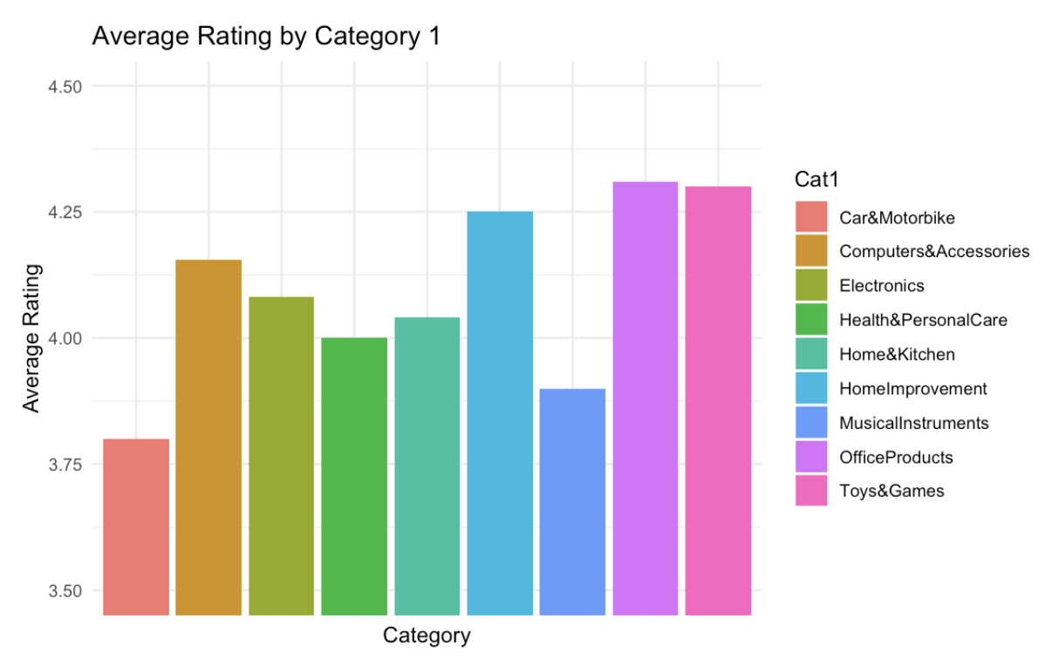
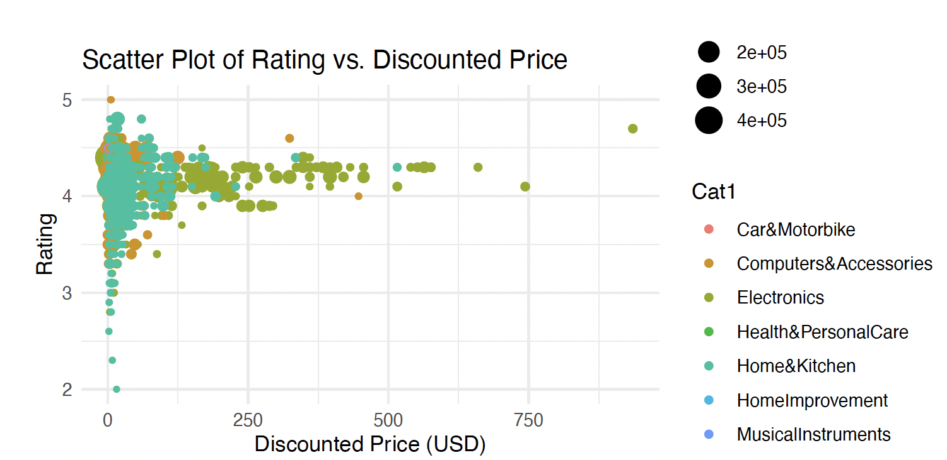
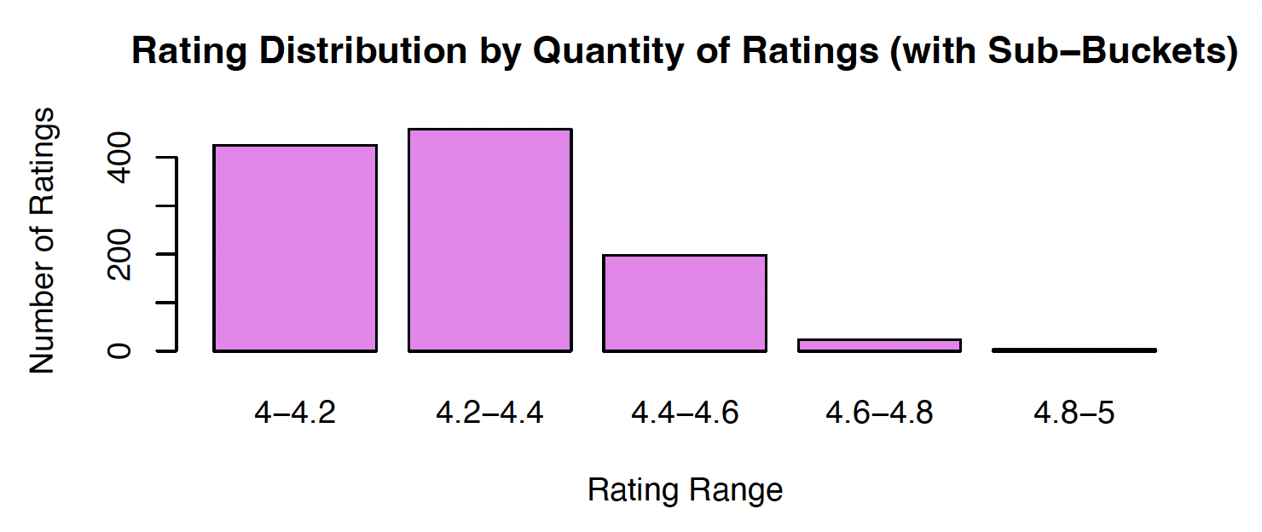
Human resources slide 5
VISUALIZATIONS

Slide 8

Human resources slide 5
VISUALIZATIONS
Wordcloud based on Review Title

Slide 9
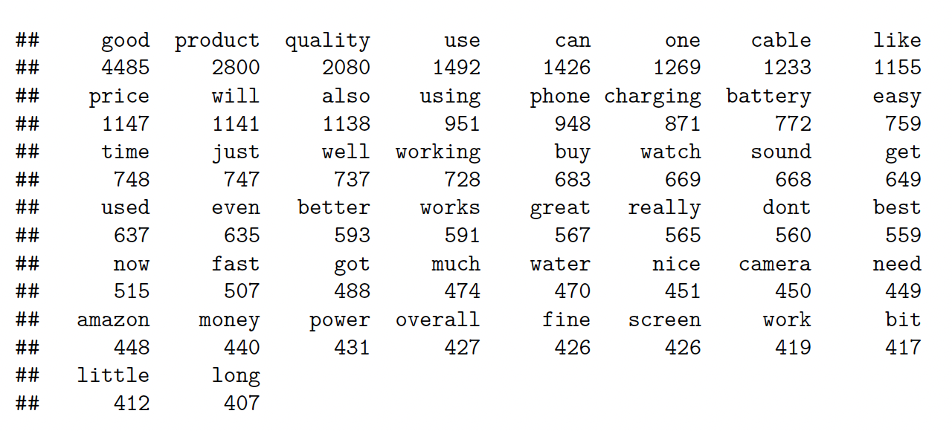
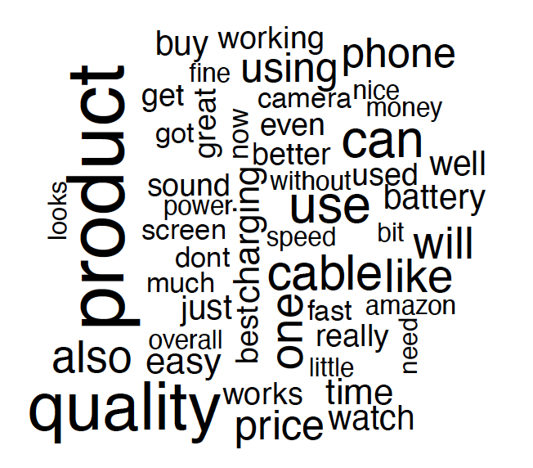
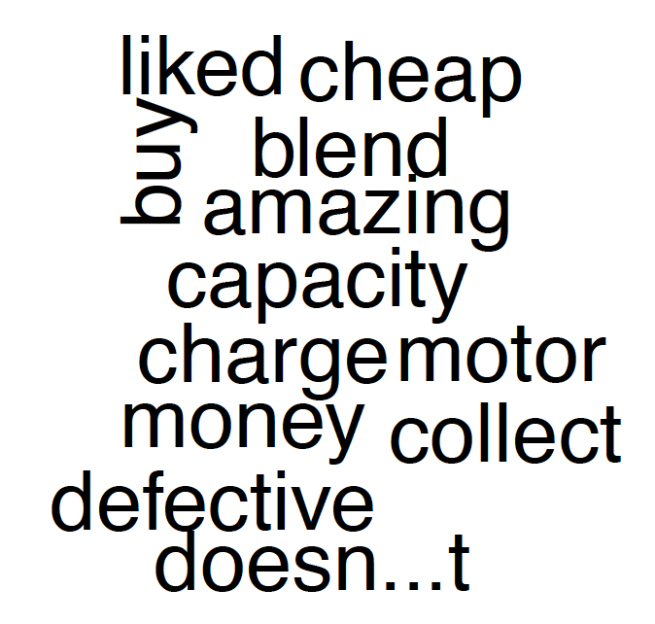
Human resources slide 5
VISUALIZATIONS
Sentiment Analysis
POSITIVE
NEGATIVE
Word Counts
Positive Reviews Only
Negative Reviews Only

Slide 10

Human resources slide 8
KEY TAKEAWAYS
Office Products have the highest ratings with a rating of 4.31/5, while Car & Motorbike has the worst average rating with 3.8/5.
Rating seems to go up as price goes up, with a positive, but weak correlation.
Home Improvement and Computers & Accessories categories had the top average discount percentage.
The word "good" showed the strongest correlation for rating with a value of 0.129, though the data provided by Amazon was biased with only 7 reviews with a rating below 3/5 and 1455 above 3/5.
Home Theater, TV and Video is the electronics subcategory that earns the most revenue.
Electronics has the highest priced products, with the Home Theater subcategory being the most expensive. The cheaper the product, the higher the number of ratings.

Slide 11
Human resources slide 10
Thank You

